Slide 1

CSC 203 / CPE 203
Week 4
Project-Based Object-Oriented
Programming and Design
(using Java)
Bill Foote
wffoote@calpoly.edu
(http://jovial.com)
Notes:
M: 1-14
T:; 1-22
W: To, or through python vars
R: UP to javadocs @ end
F: through 49

Slide 2
Announcements
Wednesday
Don’t go crazy with IntelliJ!
Design doc

Slide 3
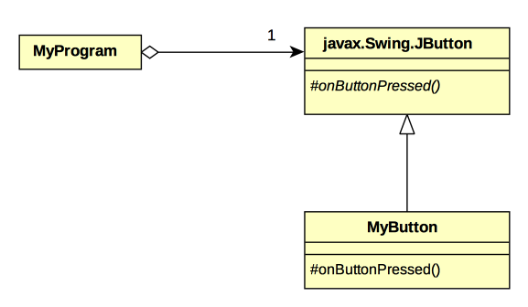

Slide 4
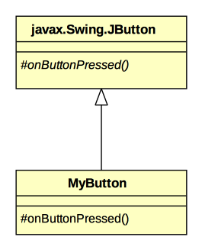


Slide 5
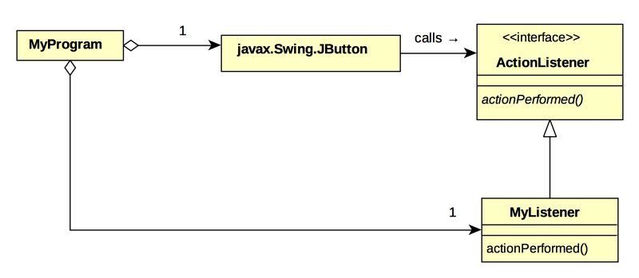

Slide 6
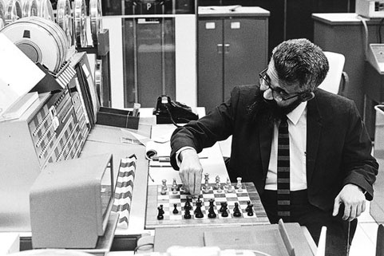
John McCarthy – LISP – 1958 (http://history-computer.com/ModernComputer/Software/LISP.html )
Alonzo Church – Lambda Calculus - 1930’s

Slide 7
Cohesion and Coupling
(not in Horstmann book)

Slide 8
Cohesion: Good
“The act or state of sticking together tightly; especially : unity”
  #1 under https://www.merriam-webster.com/dictionary/cohesion
In computer science:
  Applied at every layer of the system
  https://en.wikipedia.org/wiki/Cohesion_(computer_science)

Slide 9
Coupling: Bad unless necessary
“The act of bringing or coming together : pairing”
  https://www.merriam-webster.com/dictionary/coupling
https://en.wikipedia.org/wiki/Coupling_(computer_programming)

Slide 10
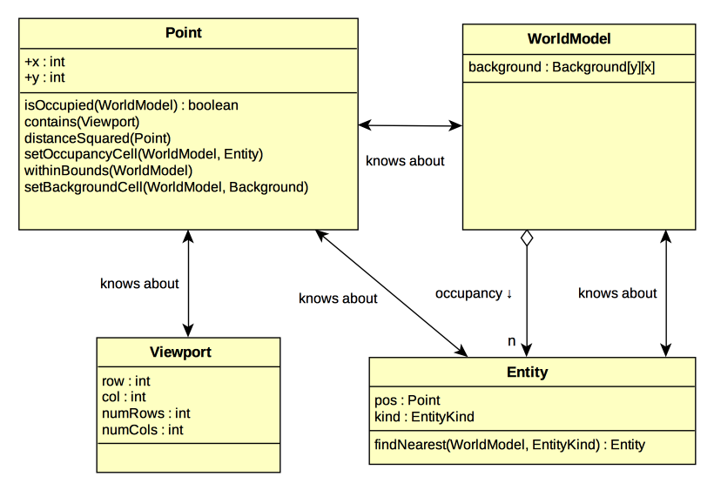

Slide 11
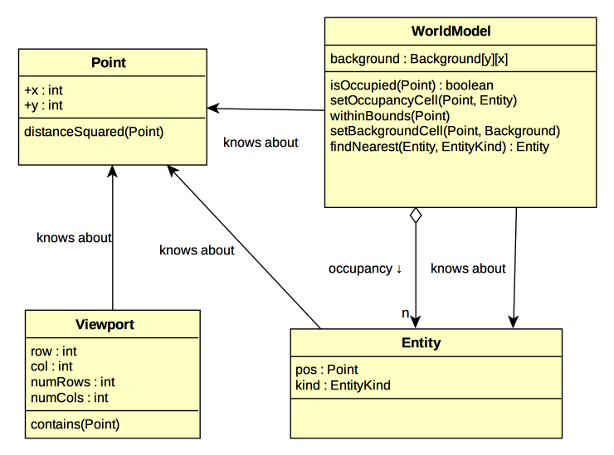

Slide 12
Assignment 3

Slide 13
Review: Meet Graphy!
(program 6)

Slide 14
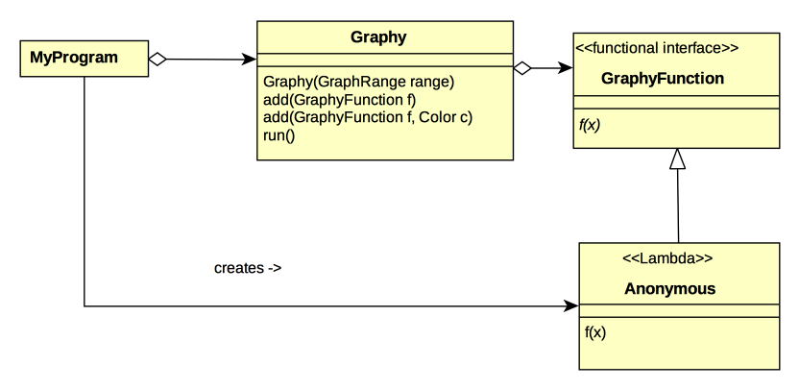

Slide 15
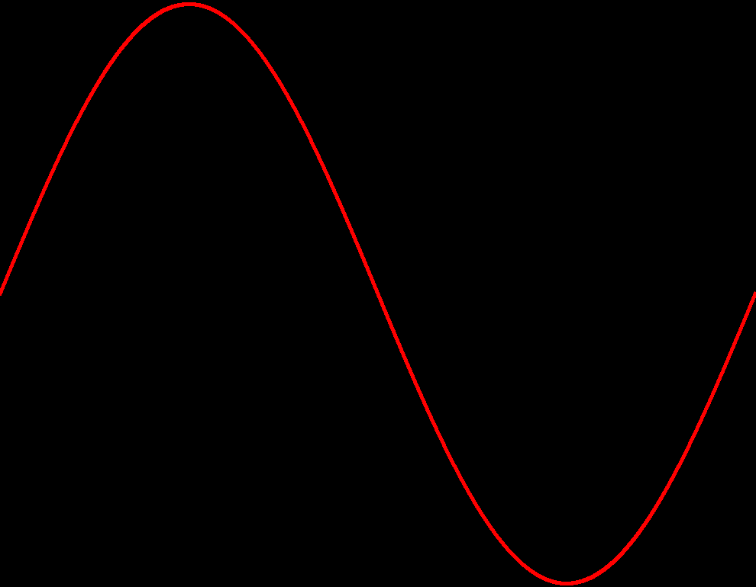
Graphy can graph everything!

Slide 16
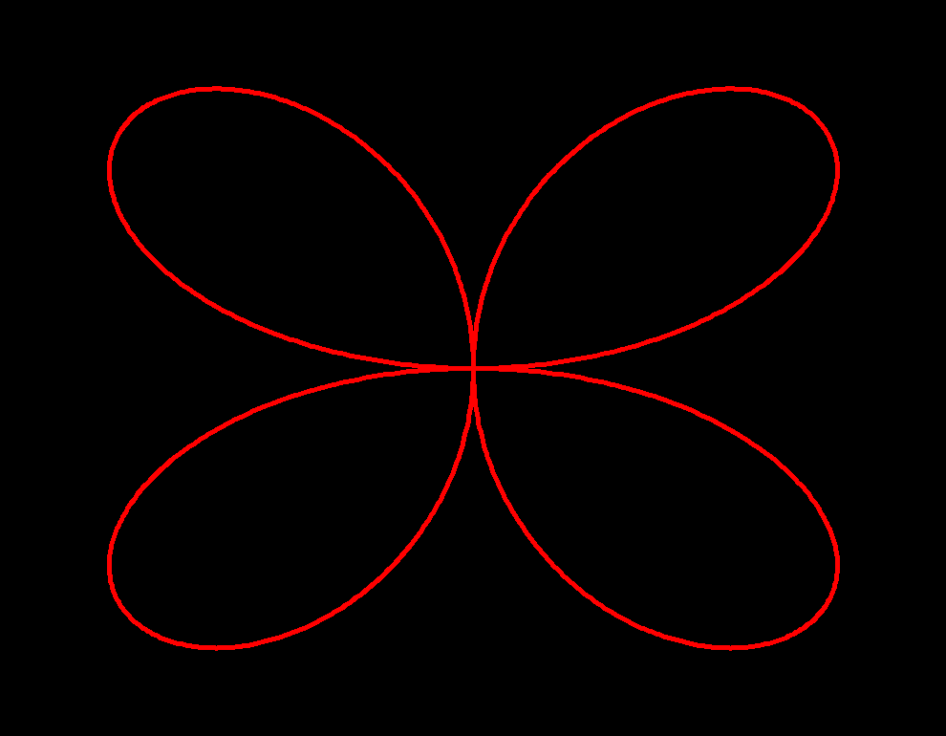

Slide 17
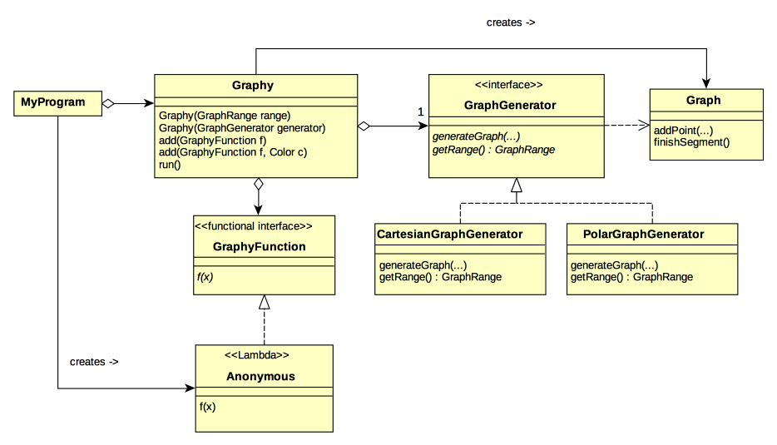
(program 7)

